Slide 1
Python Object Oriented
Università di Modena e Reggio Emilia
Prof. Nicola Bicocchi (nicola.bicocchi@unimore.it)

Slide 2
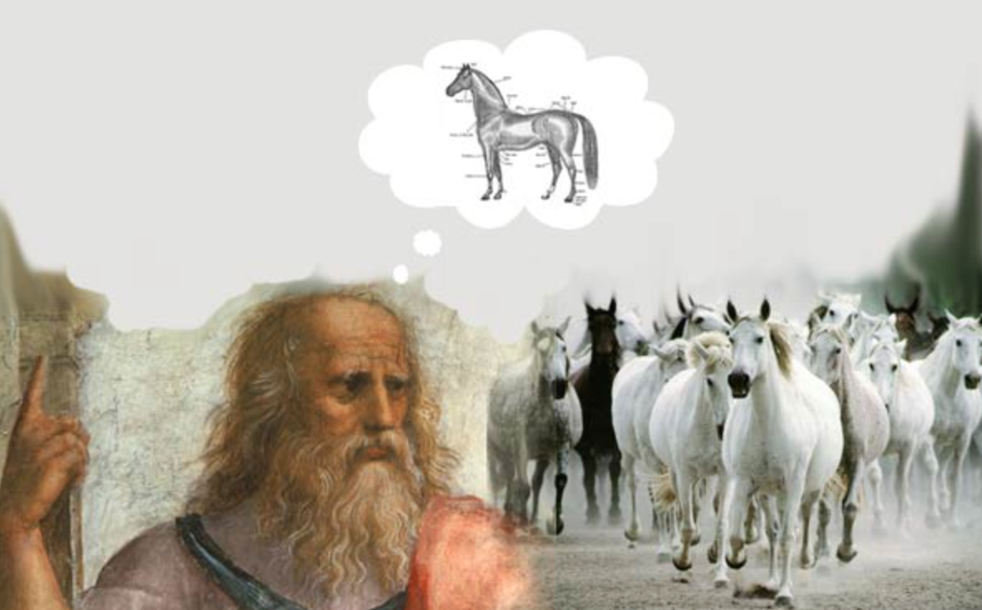
Class
Descriptor of a class of objects (Platonic idea)

Slide 3
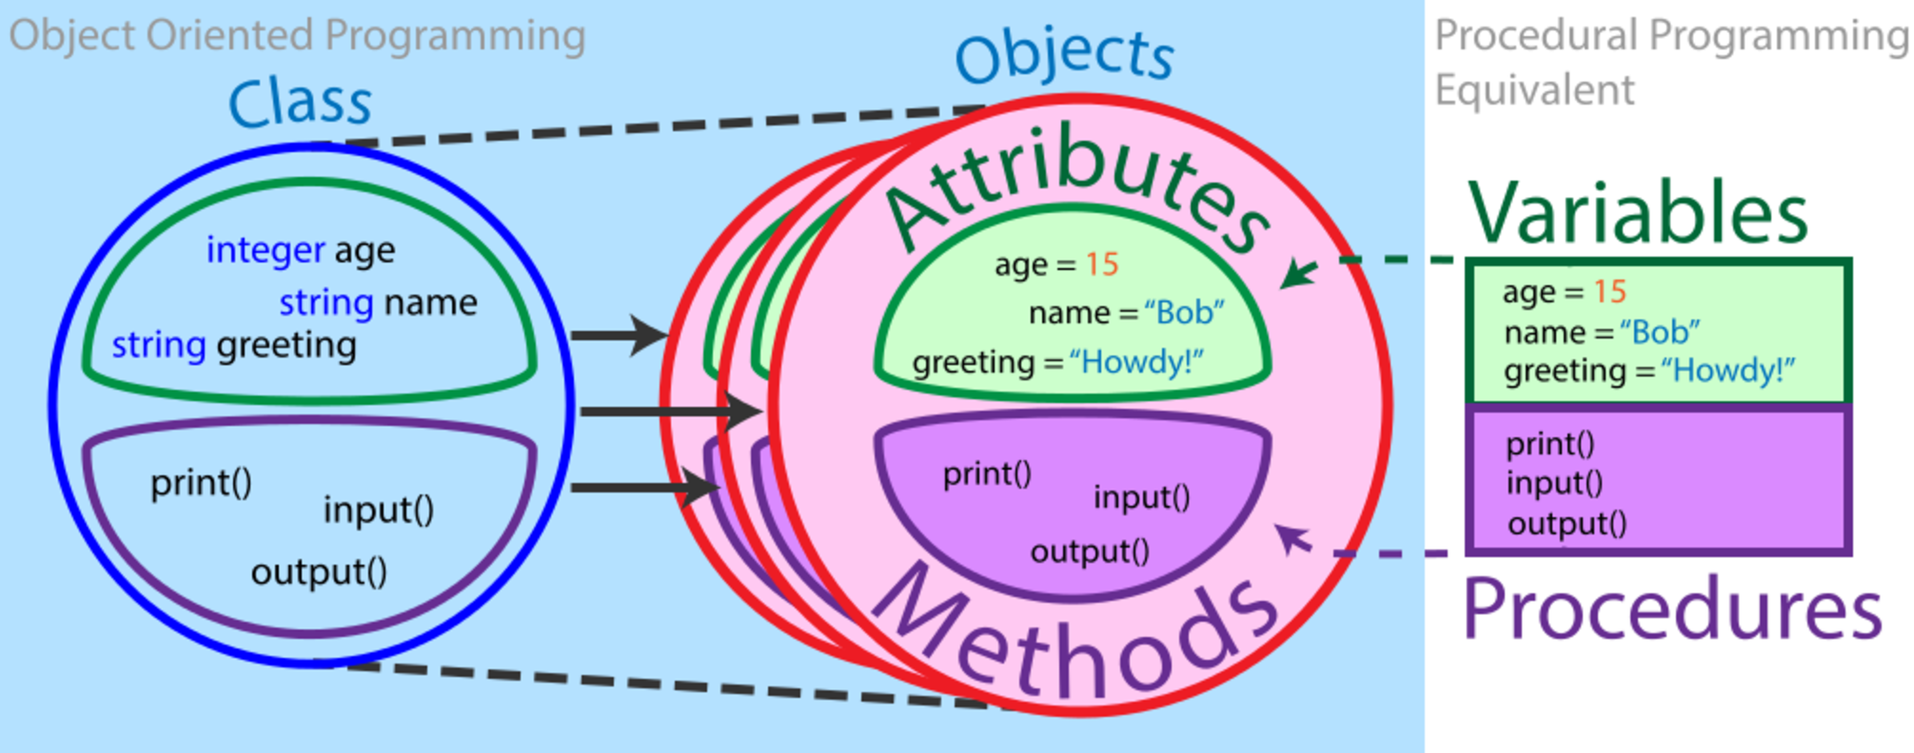
Class

Slide 4
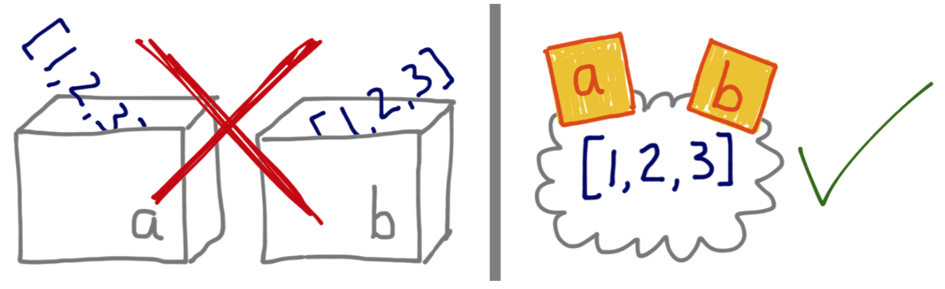
Objects and References
The usual “variables as boxes” metaphor actually hinders the understanding of reference variables in OO languages.
Python variables are like reference variables in Java, so it’s better to think of them as labels attached to objects.
a = [1, 2, 3] b = a a.append(4)
print(a) print(b)
print(a is b)
# Output
[1, 2, 3, 4]
[1, 2, 3, 4]
True

Slide 5
Objects and References
Every object has an identity, a type and a value. An object’s identityis unique and never changes once it has been created;
The id() function returns an integer representing its identity.
The == operator compares the values of objects (the data they hold), while is compares their identities.
a = [1, 2, 3]
b = [1, 2, 3]
c = a
print(id(a))
print(id(b))
print(id(c))
print(a is b)
print(a is c)
print(a == b)
print(a == c)
# Output
4503580608
4504025216
4503580608
False
True
True
True

Slide 6
Instance Attributes
class Car:
# costructor method
def __init__(self, brand, model):
# instance attributes
self.brand = brand
self.model = model
if __name__ == '__main__':
m3 = Car('Bmw', 'M3’)
print("Brand={}, Model={}".format(m3.brand, m3.model))
# Output
Brand=Bmw, Model=M3
Attributes are the properties defining any specific class of objects
Attributes are defined inside the __init__ method of the class. It is the initializer method that is first run as soon as the object is created.
On execution, we create an instance (an object) of the Car class referenced with the m3 name.
We access the instance attributes using the dot notation (m3.brand)
Instance attributes have specific values in each instance.

Slide 7
Class Attributes
class Car:
# class attribute
wheels = 4
def __init__(self, brand, model):
self.brand = brand
self.model = model
if __name__ == '__main__':
m3 = Car('Bmw', 'M3')
tsla = Car('Tesla', 'Roadster')
m3.__class__.wheels = 2
print("Wheels={}".format(m3.__class__.wheels))
print("{}, {}".format(m3.brand, m3.model))
print("Wheels={}".format(tsla.__class__.wheels))
print("{},{}".format(tsla.brand, tsla.model))
# Output
Wheels=2
Brand=Bmw, Model=M3
Wheels=2
Brand=Tesla, Model=Roadster
Outside the __init__ method we can define class attributes (wheels).
We can access the class attributes using __class__.attribute
Class attributes are shared among all instances of a class.

Slide 8
Constructors
Constructors are generally used for instantiating an object.
The task of constructors is to initialize(assign values) to the data members of the class when an object of class is created.
In Python the __init__() method is called the constructor and is always called when an object is created.
Unlike Java, you cannot define multiple constructors in Python.
However, you can define a default value if one is not passed.
class Car: # constructor def __init__(self, brand='Fiat', model='Punto'): # instance attribute self.brand = brand self.model = model if __name__ == '__main__': m3 = Car('Bmw', 'M3') punto = Car() print("{} {}".format(m3.brand, m3.model)) print("{} {}".format(punto.brand, punto.model))
# Output
Bmw M3
Fiat Punto

Slide 9
Garbage Collector
Whenever you create an object in Python, the underlying C object has both a Python type (such as list, dict, or function) and a reference count.
At a very basic level, a Python object’s reference count is incremented whenever the object is referenced, and it’s decremented when an object is dereferenced. If an object’s reference count is 0, the memory for the object is deallocated.
# For calling garbage collection explicitely
import gc
gc.collect()
# For counting references
import sys a = 'my-string' b = [a]
c = { 'key': a } sys.getrefcount(a)

Slide 10
Destructors
Destructors are called when an object gets destroyed. In Python, destructors are not needed as much needed in C++ because Python has a garbage collector that handles memory management automatically.
The __del__() method is a known as a destructor method in Python. It is called when all references to the object have been deleted i.e when an object is garbage collected.
class Car:
# constructor
def __init__(self, brand, model):
# instance attribute
self.brand = brand
self.model = model
# destructor
def __del__(self):
print('Object destroyed!')
if __name__ == '__main__':
m3 = Car('Bmw', 'M3')
del m3

Slide 11
Methods
Methods are functions defined inside the body of a class. They are used to define the behaviors of an object.
Instance methods are called on instances of a class (objects).
class Car:
# constructor
def __init__(self, brand, model):
# instance attribute
self.brand = brand
self.model = model
def run(self, speed):
return '{} {} is running at {}km/h'.format(self.brand, self.model, speed)
def brake(self):
return '{} {} is braking'.format(self.brand, self.model)
if __name__ == '__main__':
m3 = Car('Bmw', 'M3')
print(m3.run(90))
print(m3.brake())

Slide 12
@staticmethod
A static method is a method which is bound to the class and not the object of the class.
A static method can’t access or modify class state.
It is present in a class because it makes sense for the method to be present in class.
Generally used to create utility functions.
class Car:
def __init__(self, brand, model):
# instance attribute
self.brand = brand
self.model = model
@staticmethod
def within_limits(speed, maxspeed):
return speed < maxspeed
if __name__ == '__main__':
m3 = Car('Bmw', 'M3')
print(Car.within_limits(75, 90))

Slide 13
@classmethod
A class method is a method which is bound to the class and not the object of the class.
They have the access to the state of the class as it takes a class parameter that points to the class and not the object instance.
It can modify a class state that would apply across all the instances of the class.
Generally used cto create factory methods. Factory methods return class object (similar to a constructor).
class Car:
def __init__(self, brand, model):
# instance attribute
self.brand = brand
self.model = model
@classmethod
def from_chars(cls, c):
return cls(c * 6, c * 6)
if __name__ == '__main__':
acar = Car.from_chars('a')
print("{} {}".format(acar.brand, acar.model))

Slide 14
String representation
__repr__ in interally called by the repr() standard function
__repr__, and __str__ return a string representation of the object
if __repr__ is defined, and __str__ is not, the object will behave as though __str__=__repr__.
This means, in simple terms: almost every object you implement should have a functional __repr__ that’s usable for understanding the object. Implementing __str__ is optional: do that if you need a “pretty print” functionality (for example, used by a report generator).
class Car:
def __init__(self, brand, model):
self.brand = brand
self.model = model
def __repr__(self):
return '{} {}'.format(self.brand, self.model)
if __name__ == '__main__':
m3 = Car('Bmw', 'M3')
print(m3)
# Output without __repr__()
<__main__.Car object at 0x10aa1cdc0>
# Output with __repr__()
Bmw M3

Slide 15
String representation
class Car:
def __init__(self, brand, model):
self.brand = brand
self.model = model
def __repr__(self):
return '{} {}'.format(self.brand, self.model)
def __str__(self):
return 'This is a {}. Model {}.'.format(self.brand, self.model)
if __name__ == '__main__':
m3 = Car('Bmw', 'M3')
print(m3)
print(repr(m3))
# Output
This is a Bmw. Model M3.
Bmw M3

Slide 16
String representation
class Car:
def __init__(self, brand, model):
self.brand = brand
self.model = model
def __repr__(self):
return '{} {}'.format(self.brand, self.model)
if __name__ == '__main__':
m3 = Car('Bmw', 'M3')
print(m3)
print(repr(m3))
# Output
Bmw M3
Bmw M3

Slide 17
__doc__
docstring is a short for documentation string.
Python docstrings are the string literals that appear right after the definition of a function, method, class, or module. Triple quotes are used.
The docstring is available as the __doc__ attribute.
class Car:
"""
A simple class for representing a car
with a brand and a model name
"""
def __init__(self, brand, model):
self.brand = brand
self.model = model
if __name__ == '__main__':
m3 = Car('Bmw', 'M3')
print(m3.__doc__)
print(Car.__doc__)

Slide 18
Encapsulation
Using OOP in Python, we can restrict access to methods and variables.
This prevents data from direct modification which is called encapsulation.
In Python, we denote private attributes using underscore as the prefix:
self._varname
self.__varname
Getters and setters are needed for manipulating private attributes
class Car:
def __init__(self, brand, model, licence):
self.__licence = licence
self.brand = brand
self.model = model
def get_licence(self):
return self.__licence
def set_licence(self, licence):
self.__licence = licence
if __name__ == '__main__':
m3 = Car('Bmw', 'M3', 'GY455AI')
m3.set_licence('FY345YT')
print(m3.get_licence())
print(m3.__licence)
# Output
FY345YT
AttributeError: 'Car' object has no attribute '__licence'

Slide 19
Inheritance
Inheritance allows us to define a class that inherits all the methods and properties from another class.
The class which get inherited is called base class or parent class. The class which inherits the other class is called child class or derived class.
The derived class inherits all attributes and methods from base classe. Furthermore it can:
add attributes and methods
redefine existing methods
Python has a super function which allows us to access temporary object of the super class. The super function is usually used in constructurs of derived classes
class Car:
def __init__(self, brand, model):
self.brand = brand
self.model = model
def brake(self):
return '{} {} is braking'.format(self.brand, self.model)
class ECar(Car):
def __init__(self, brand, model, battery_cycles):
super().__init__(brand, model)
self.battery_cycles = battery_cycles
def charge(self):
return '{} {} is charging'.format(self.brand, self.model)
if __name__ == '__main__':
tsla = ECar('Tesla', 'ModelX', 0)
print(tsla.brake())
print(tsla.charge())

Slide 20
Polymorphism
In inheritance, the child class inherits the methods from the parent class.
However, it is possible to modify a method in a child class that it has inherited from the parent class.
In such cases, we re-implement the method in the child class. This process of re-implementing a method in the child class is known as method overriding.
Method overriding eventually leads to polymorphism.
class Car:
def __init__(self, brand, model):
self.brand = brand
self.model = model
def brake(self):
return '{} {} is braking'.format(self.brand, self.model)
class ECar(Car):
def __init__(self, brand, model, battery_cycles):
super().__init__(brand, model)
self.battery_cycles = battery_cycles
def brake(self):
return '{} {} is regenerating'.format(self.brand, self.model)
if __name__ == '__main__':
m3 = Car('Bmw', 'M3')
tsla = ECar('Tesla', 'ModelX', 10)
print(m3.brake())
print(tsla.brake())

